Slide 1
Premier Data – Phase III
Ali Lacey, Thomas Pattara, Sydney Palmer, Nikita Medvedev

Slide 2

Group 8’s Data Set
Original data - 26 variables
Original data – 91,502 observations
Cleaned Data
17 Variables
1 Line per Customer
9,997 Distinct Customers

Slide 3
Bad Variable
Bad is a binary variables (dummy variable – 1/0)
External Status – Z (Charged Off), F (Frozen), I (Interest Prohibited), and E (Revoked) received 1
Open accounts 30 days or more past due received 1
Closed Accounts with a closed profit less than 0 received a 1
Closed Profit = 0.03*Total Purchases – Ending Balance

Slide 4
Logistic Regression
Logistic Regression | Estimate | Std. Error | z value | Pr(>|z|)
(Intercept) | 3.5192291 | 1.267289 | 2.777 | 0.00549
Months.On.Book | 0.0143387 | 0.003129 | 4.582 | 4.60E-06
Quarterly.Fico.Score | 0.0020384 | 0.001102 | 1.849 | 0.06444
Behavior.Score | -0.015569 | 0.001596 | -9.753 | < 2e-16
Over.limit | -0.458991 | 0.189314 | -2.424 | 0.01533
Avg.Days.Deliq | 0.0501953 | 0.010227 | 4.908 | 9.19E-07
Net.Purchases.Total | -0.000601 | 0.000247 | -2.44 | 0.0147
Net.Premier.Fees.Billed.Total | -0.012449 | 0.001544 | -8.061 | 7.54E-16
Net.Behavior.Fees.Total | -0.004264 | 0.001751 | -2.435 | 0.01491
Actual.Min.Pay.Due.Total | 0.0126487 | 0.001609 | 7.863 | 3.76E-15
Accuracy | 95% CI | No Information Rate | P-Value [Acc > NIR] | Kappa | Mcnemar's Test P-Value
0.974 | (0.9685, 0.9787) | 0.7572 | < 2.2e-16 | 0.931 | 8.37E-07
 | Predicted
Actual | 0 | 1
0 | 2920 | 26
1 | 77 | 935
Prediction Accuracy: 97.4%

Slide 5
Regression Tree

Slide 6
Regression Tree
Overall
Actual.Min.Pay.Due.Total | 1755.05
Avg.Days.Deliq | 1966.69
Behavior.Score | 1868.7
Net.Behavior.Fees.Total | 71.9959
Net.Premier.Fees.Billed.Total | 506.005
Over.limit | 11.8474
Quarterly.Fico.Score | 526.999
Net.Purchases.Total | 0
 | Predicted
Actual | 0 | 1
0 | 2928 | 18
1 | 78 | 934
Prediction Accuracy: 97.5%
Accuracy | 95% CI | No Information Rate | P-Value [Acc > NIR] | Kappa | Mcnemar's Test P-Value
0.9757 | (0.9705, 0.9803) | 0.7595 | < 2.2e-16 | 0.935 | 1.73E-09

Slide 7
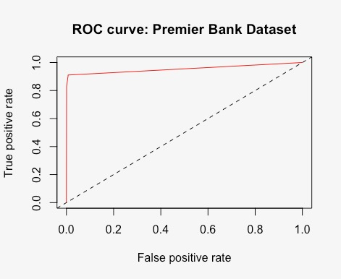
ROC Curve
The ROC is very accurate. This could be due to over fitting or to over-biased variables used in the model.

Slide 8
Results
Both model had a very high accuracy on the validation set
Our model is over fitting the data and is not robust
Our model is subject to bias
Tail Data
Model only know how to model around the mean
We see this in our split for Behavior Score >= 540

